Slide 1
Secure data hiding in images using steganography
CAPSTONE PROJECT
Presented By: ARTHI R
Student Name : ARTHI R
College Name & Department : Reva University, CSE

Slide 2
OUTLINE
Problem Statement
Technology used
Wow factor
End users
Result
Conclusion
Git-hub Link
Future scope

Slide 3
Problem Statement
Traditional encryption methods can attract attention, making secure communication challenging. This project uses image steganography to hide sensitive messages within images, ensuring discreet data transmission. Users can encrypt messages with a password and later decrypt them securely. This approach enhances data privacy, security, and stealth communication.

Slide 4
Technology used
LSB Steganography: Hides messages in images by modifying the least significant bits of pixel values.
Algorithms: The message and password are embedded into the least significant bits of image pixels, ensuring minimal perceptual changes.
Frontend: HTML, CSS, JavaScript for user interface.
Backend: Python (Flask) for handling encryption and decryption requests.
Libraries Used:
OpenCV (cv2) for image processing.
NumPy for handling numerical operations on images.
Flask for setting up a REST API to process image encryption and decryption.
Flask-CORS for handling cross-origin requests.

Slide 5
Wow factors
Password-Protected Encryption: Ensures only authorized users can retrieve hidden messages.
Secure LSB-Based Algorithm: Uses Least Significant Bit (LSB) steganography for effective message embedding.
User-Friendly Interface: Simple frontend for seamless encryption and decryption of images.
Cross-Platform Compatibility: Works on Windows, macOS, and Linux with Flask-based backend.
Optimized Performance: Uses NumPy and OpenCV for fast image processing without significant quality loss

Slide 6
End users
Cybersecurity Professionals – Use steganography for secure communication and data privacy.
Journalists & Activists – Hide sensitive information to protect sources and confidential data.
Forensic Experts – Apply steganography techniques for digital forensics and evidence protection.
Developers & Researchers – Explore image-based encryption for security-focused applications.
General Users – Anyone looking for a simple way to encrypt and hide messages in images.

Slide 7

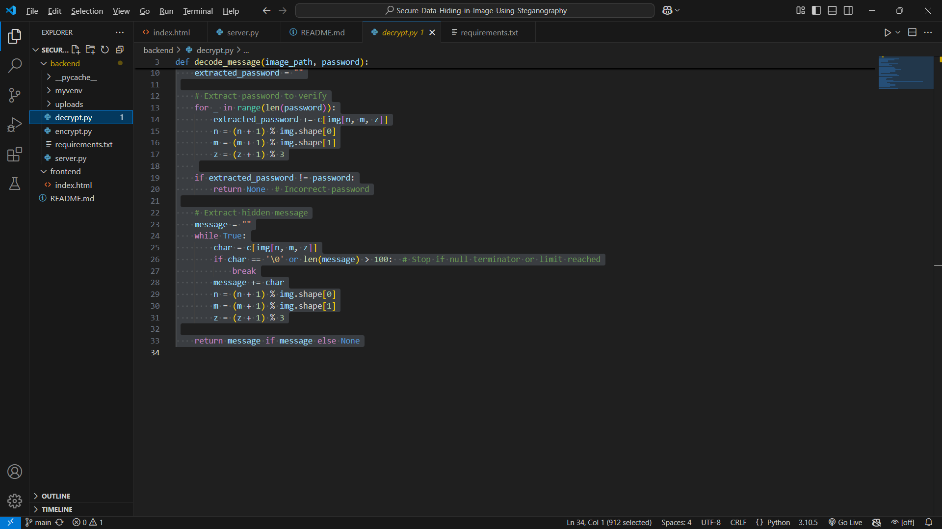

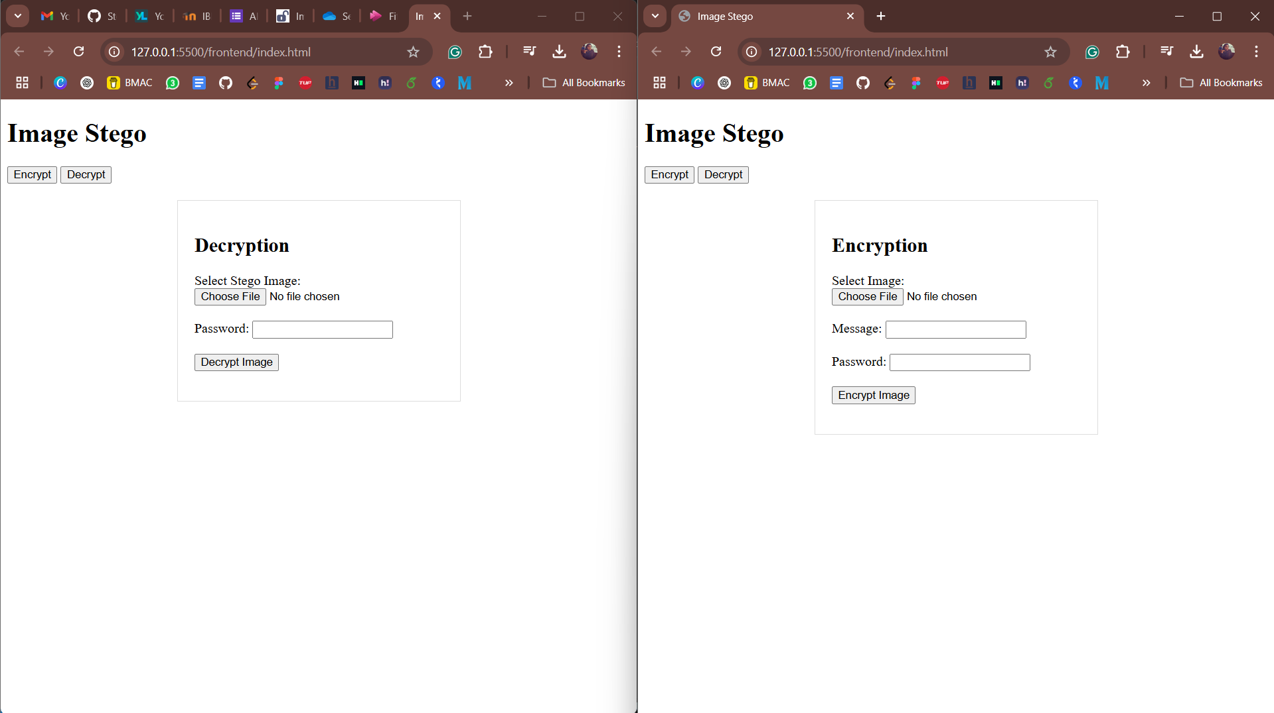
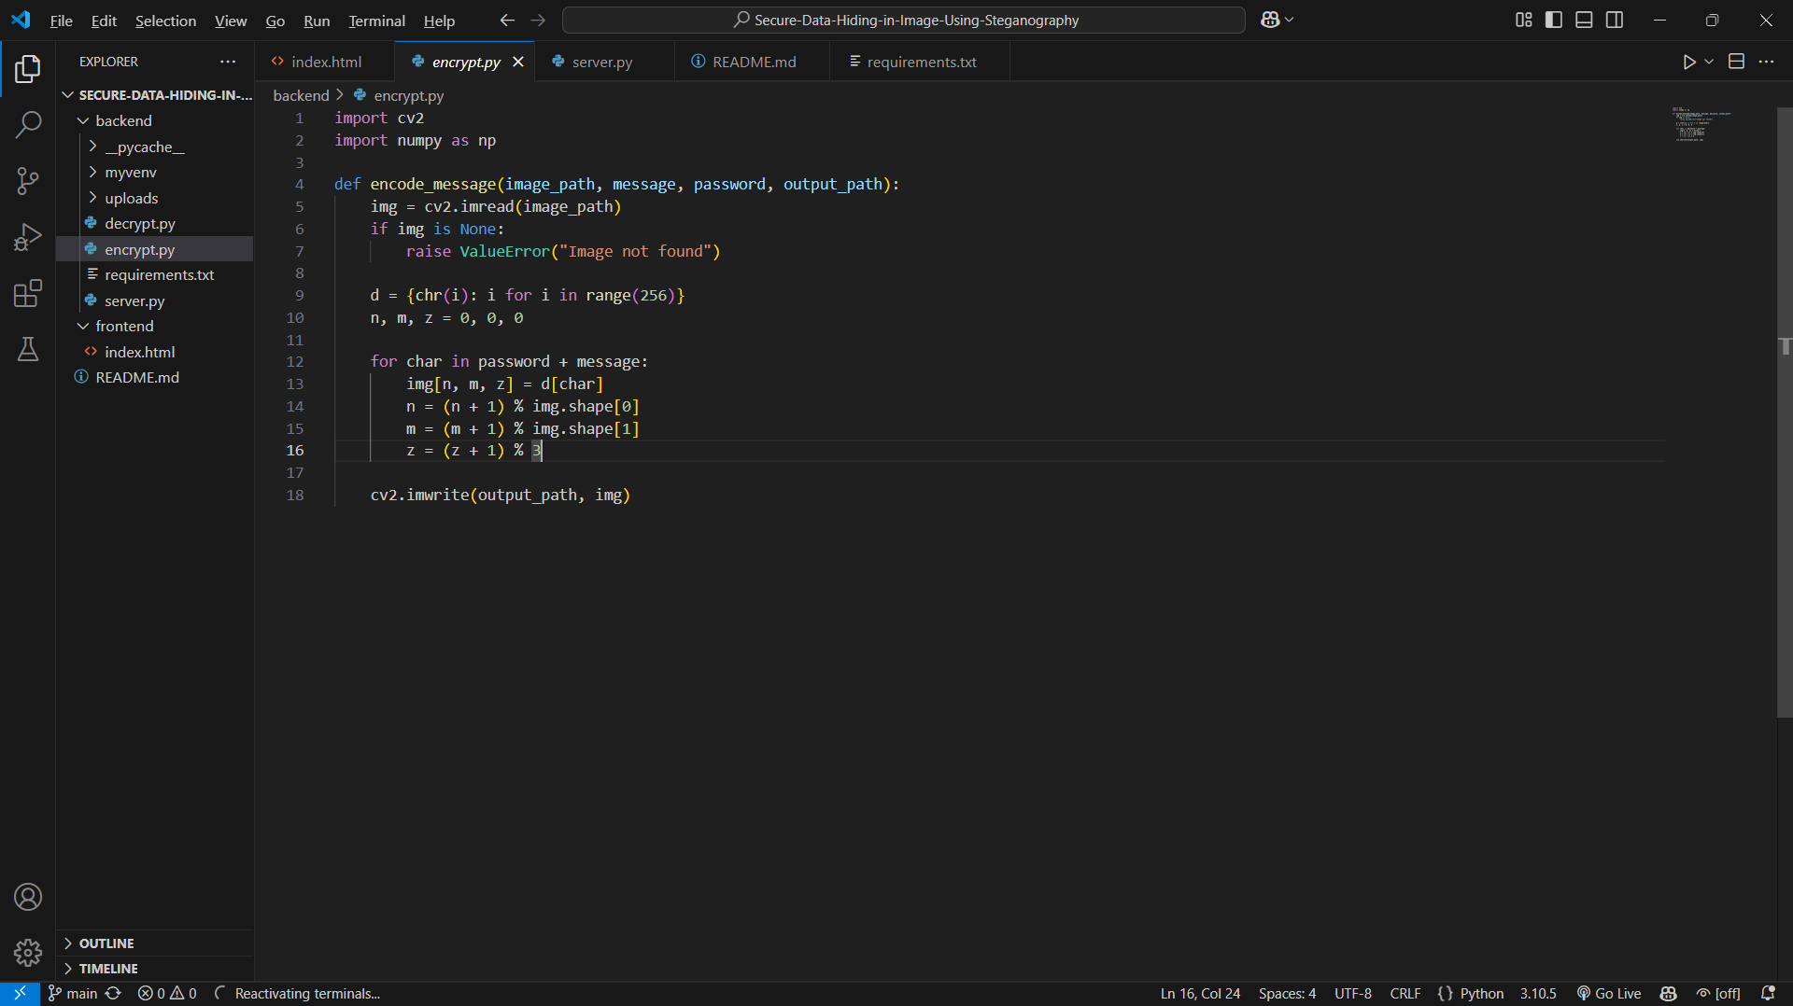
Results
Initial image
encrypted image

Slide 8
Conclusion
This project effectively addresses the challenge of secure data hiding by leveraging steganography techniques to embed encrypted messages within images. By integrating a password-based encryption system, it ensures that only authorized users can access hidden information, enhancing data privacy and security. The seamless frontend-backend interaction provides an intuitive user experience for encryption and decryption. Overall, this solution offers a practical and efficient approach to confidential communication, making it suitable for various security-critical applications.

Slide 9
GitHub Link
https://github.com/kutty023/Secure-Data-Hiding-in-Image-Using-Steganography

Slide 10
Future scope(optional)
Enhanced Security – Implement advanced encryption techniques like AES alongside steganography for added security.
Support for Multiple File Formats – Extend compatibility to other image formats (e.g., PNG, BMP) and even video or audio files.
Cloud Integration – Enable secure storage and retrieval of stego-images via cloud services.
Mobile Application – Develop an Android/iOS app for on-the-go secure message hiding and retrieval.
AI-Powered Steganalysis Resistance – Improve resistance against steganalysis using AI-based techniques to make hidden data harder to detect.

Slide 11
THANK YOU

